Slide 1
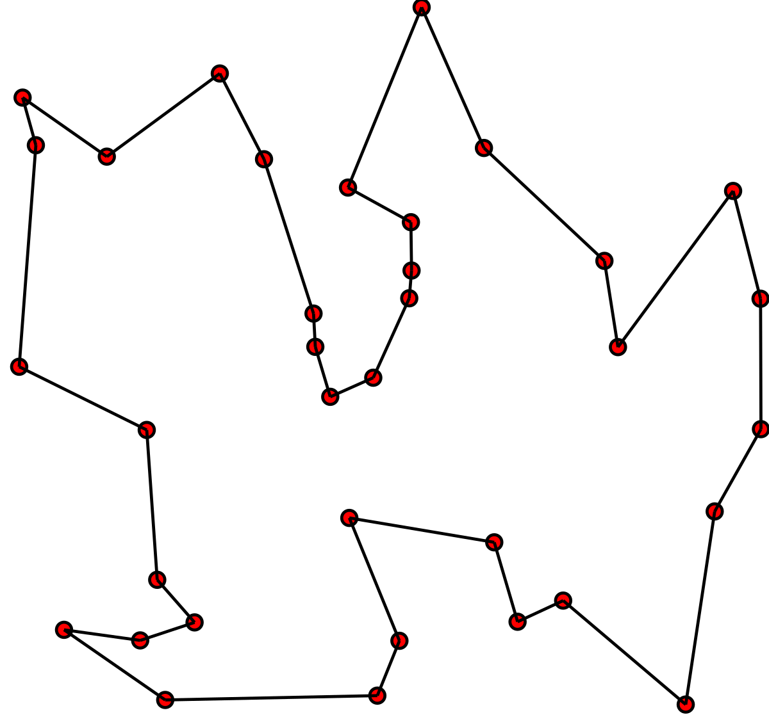
Travelling Salesman Problem

Slide 2

The Problem
Given $n$ cities and the cost $c_{ij}$ of travelling between each pair of cities $(i,j)$.
Find the cheapest way of visiting all cities and returning to your starting point.

Slide 3
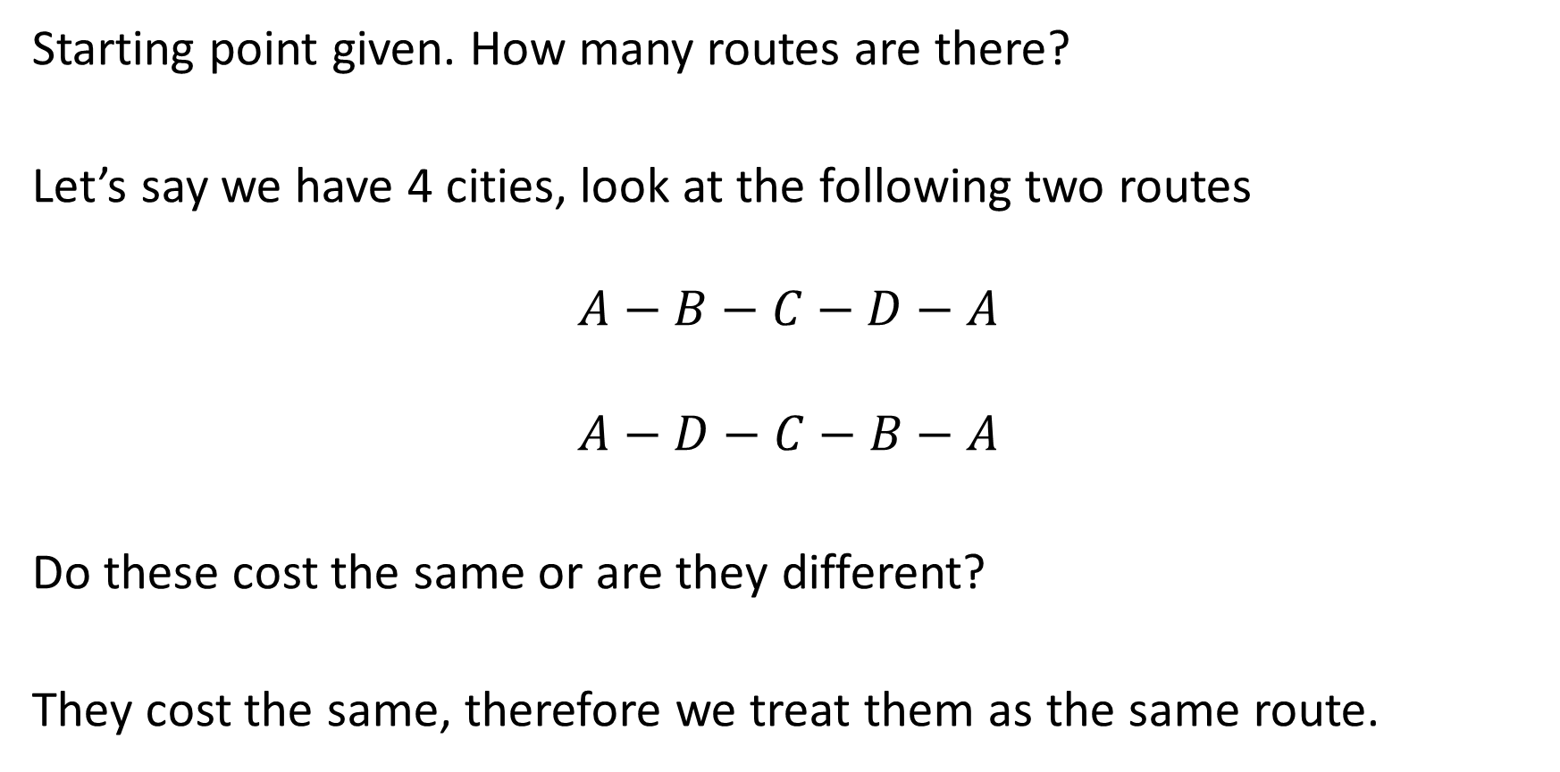
Complexity
Starting point given. How many routes are there?
Let’s say we have 4 cities, look at the following two routes
$$A−B−C−D−A$$
$$A−D−C−B−A$$
Do these cost the same or are they different?
They cost the same, therefore we treat them as the same route.

Slide 4

Complexity
From our starting point, how many choices do we have for the next city?
$$3=4−1$$
For our next city?
$$2=3−1$$
Thus, we have $3!$ Possible choices? Are we done?
No, you can go in either direction
$$A−B−C−D−A$$
$$A−D−C−B−A$$
Divide by 2
$$\frac{3!}{2}$$

Slide 5
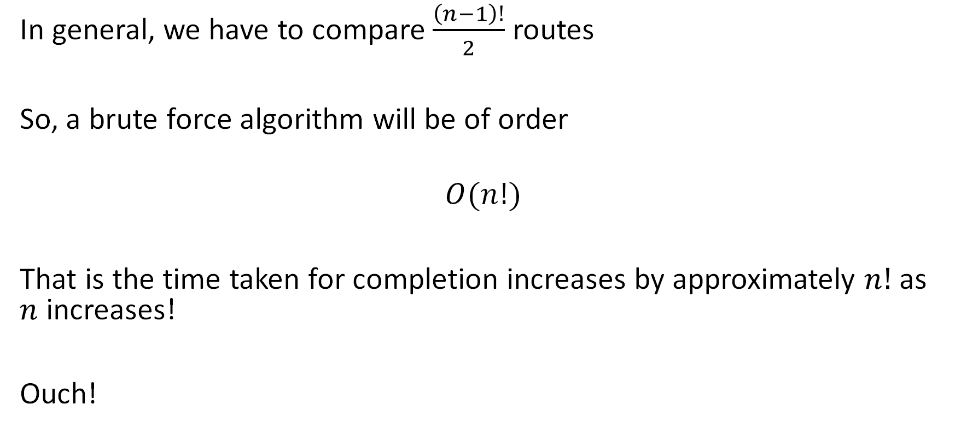
Complexity
In general, we have to compare $\frac{\left(n−1\right)!}{2}$ routes
So, a brute force algorithm will be of order
$$O(n!)$$
That is the time taken for completion increases by approximately $n!$ as $n$ increases!
Ouch!

Slide 6
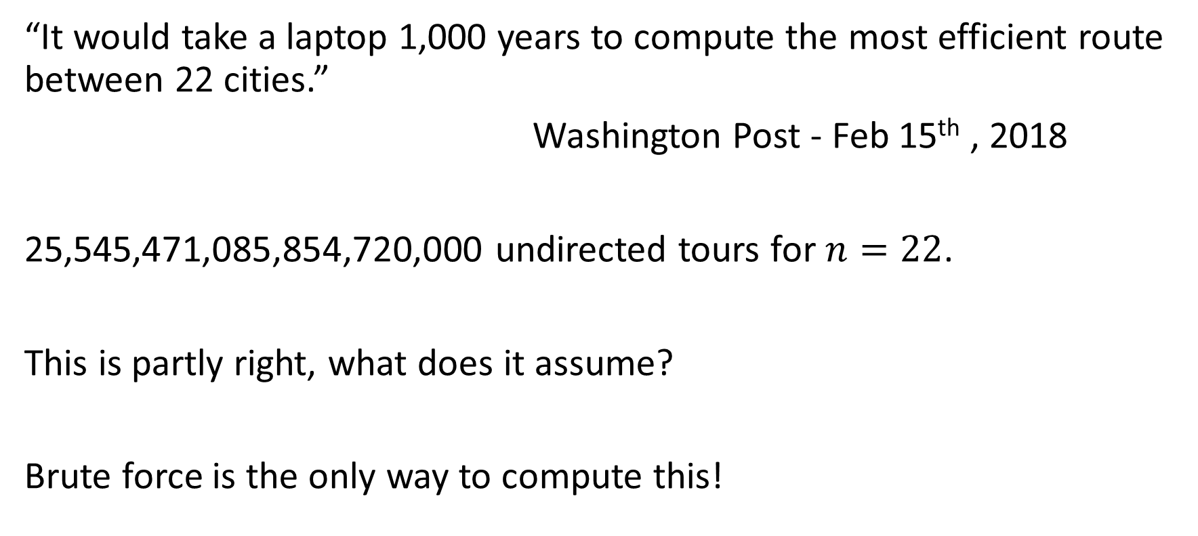
Some Numbers…
“It would take a laptop 1,000 years to compute the most efficient route between 22 cities.”
Washington Post - Feb 15th , 2018
25,545,471,085,854,720,000 undirected tours for $n=22$.
This is partly right, what does it assume?
Brute force is the only way to compute this!

Slide 7
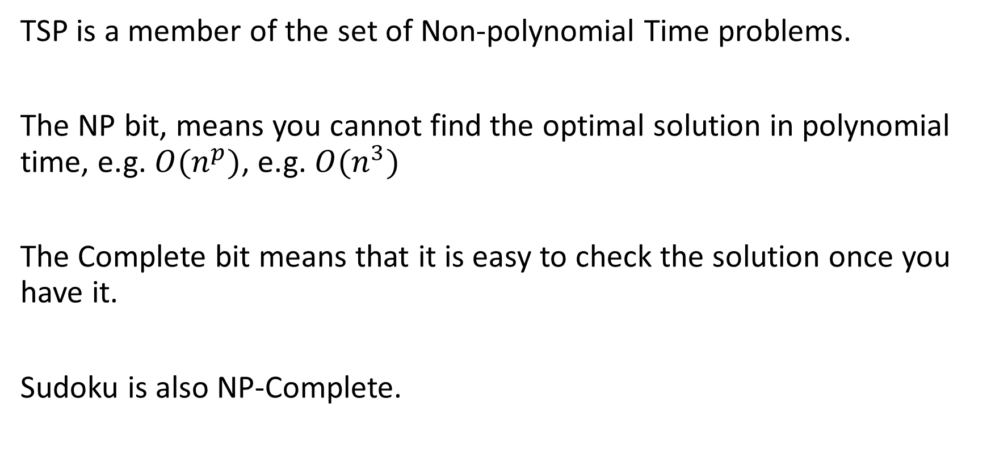
NP-Complete
TSP is a member of the set of Non-polynomial Time problems.
The NP bit, means you cannot find the optimal solution in polynomial time, e.g. $O(n^{p})$, e.g. $O(n^{3})$
The Complete bit means that it is easy to check the solution once you have it.
Sudoku is also NP-Complete.

Slide 8
$$P≠NP$$
$1,000,000 Millennium Problem
An algorithm that solves TSP in polynomial time would win you $1,000,000.

Slide 9
Applications
Routing/Timetabling/Scheduling
Bus Routes
Service Calls by BT/Sky
Manufacturing Process
Drilling the holes in a circuit board, in which order does the machine do this?

Slide 10
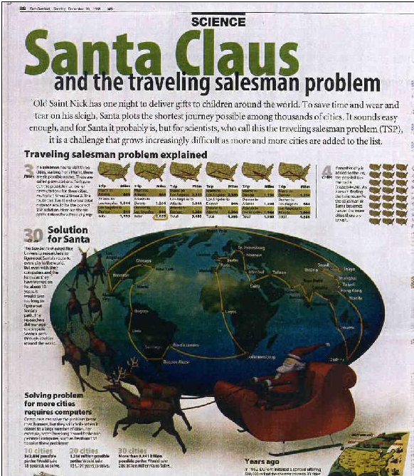
TSP in the news…
Florida Sun-Sentinel presented the following article on 20 December 1998

Slide 11
William Cook
University Professor, Combinatorics and Optimization, University of Waterloo
https://www.math.uwaterloo.ca/~bico/
Written many books and given excellent presentation on TSP
Well worth a look

Slide 12

MILP
Let $x_{ij}$ represent whether the edge $(i,j)$ connecting city $i$ and city $j$ and $c_{ij}$ be the cost of that edge.
Then we could try and model the problem as:
$$\text{min}\text{. }\sum_{\left(i,j\right)∈E}{c_{ij}x_{ij}} \\ s.t.$$
$$\sum_{j=1:i≠j}^{n}{x_{ij}=1 ∀i∈\{1, …n\}}$$
$$\sum_{j=1:i≠j}^{n}{x_{ji}=1 ∀i∈\{1, …n\}}$$
$$x_{ij}∈\{0,1\}$$
This formulation is wrong? Why?

Slide 13

MILP
$$\text{min}\text{. }\sum_{\left(i,j\right)∈E}{c_{ij}x_{ij}} \\ s.t.$$
$$\sum_{j=1:i≠j}^{n}{x_{ij}=1 ∀i∈\{1, …n\}}$$
$$\sum_{j=1:i≠j}^{n}{x_{ji}=1 ∀i∈\{1, …n\}}$$
$$x_{ij}∈\{0,1\}$$
Whilst all cities will be visited, it doesn’t guarantee a single tour!
We could have lots of subtours that cover all cities.

Slide 14
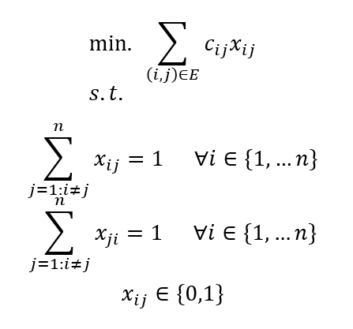
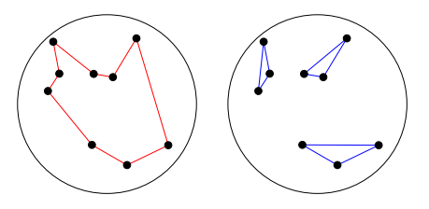
Subtour example
Both the red (complete tour) and the blue (subtours) have exactly one edge entering and one edge leaving a city!

Slide 15
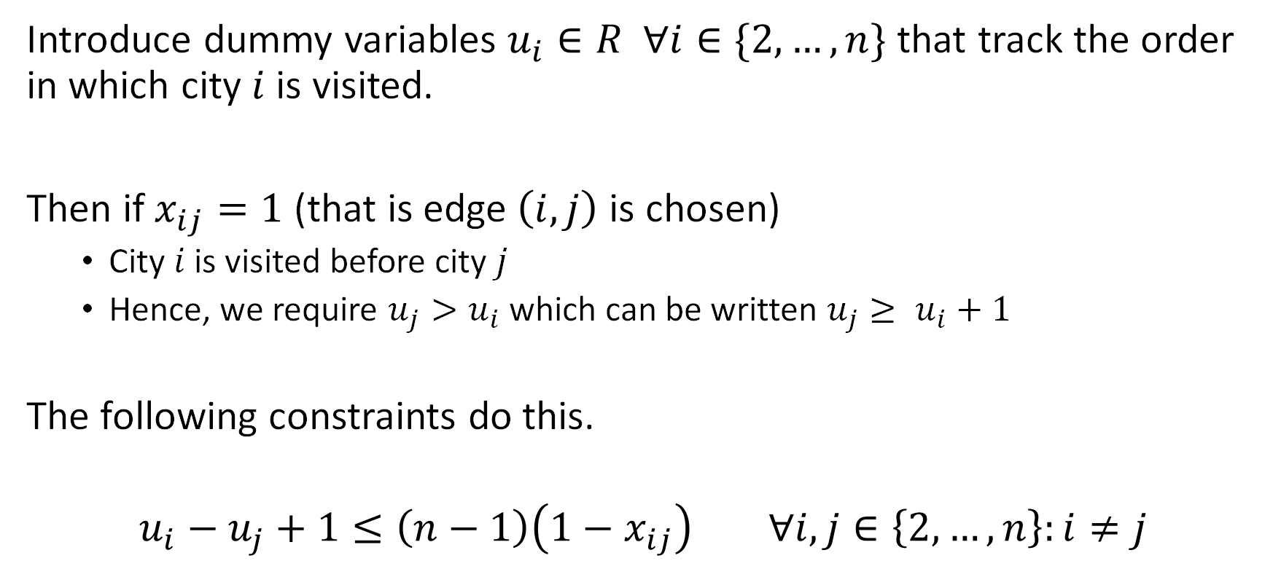
Solution
Introduce dummy variables $u_{i}∈R ∀i∈\{2,…,n\}$ that track the order in which city $i$ is visited.
Then if $x_{ij}=1$ (that is edge $\left(i,j\right)$ is chosen)
  City $i$ is visited before city $j$
  Hence, we require $u_{j}>u_{i}$ which can be written $u_{j}≥ u_{i}+1$
The following constraints do this.
$$u_{i}−u_{j}+1≤\left(n−1\right)\left(1−x_{ij}\right) ∀i,j∈\left\{2,…, n\right\}:i≠j$$

Slide 16
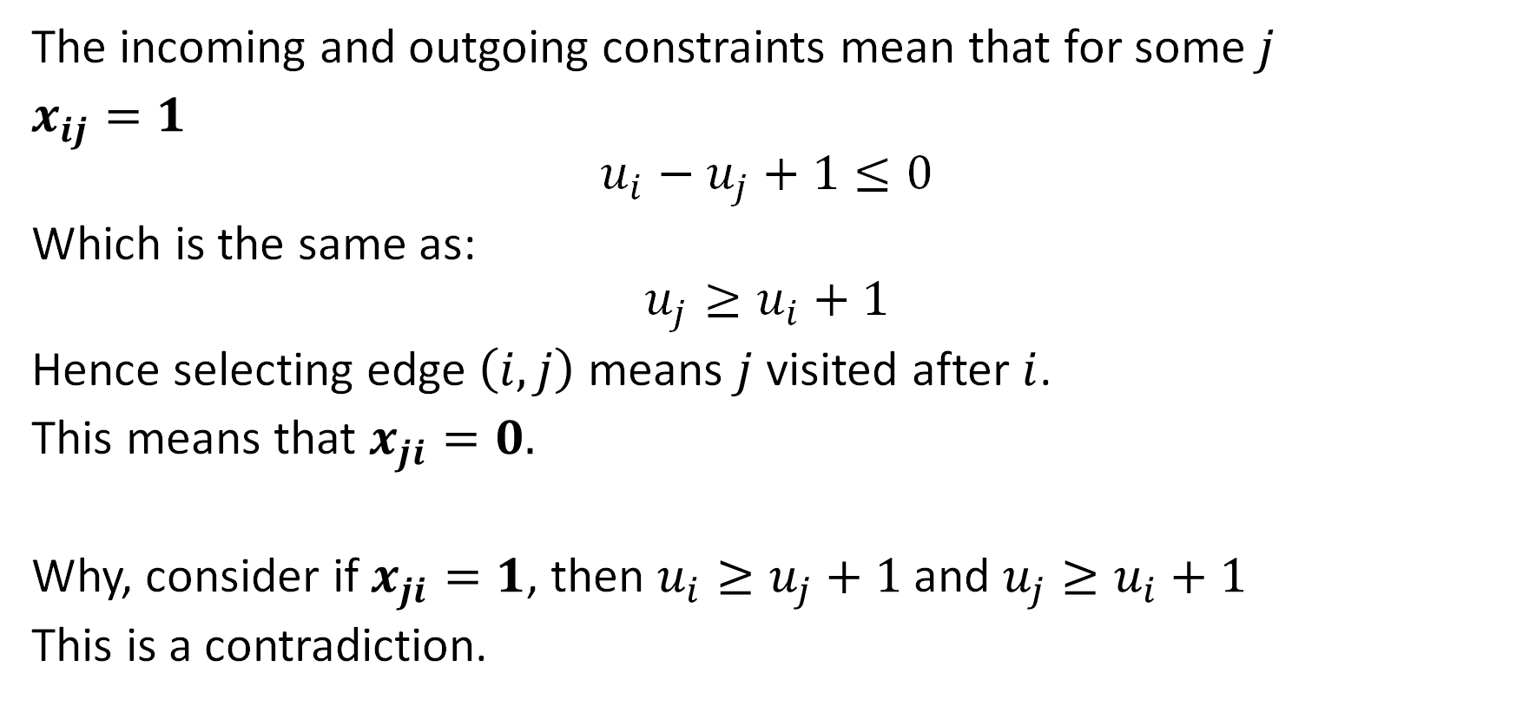
Why does this work?
The incoming and outgoing constraints mean that for some $j$
$x_{ij}=1$
$$u_{i}−u_{j}+1≤0$$
Which is the same as:
$$u_{j}≥u_{i}+1$$
Hence selecting edge $\left(i,j\right)$ means $j$ visited after $i$.
This means that $x_{ji}=0.$
Why, consider if $x_{ji}=1$, then $u_{i}≥u_{j}+1$ and $u_{j}≥u_{i}+1$
This is a contradiction.

Slide 17
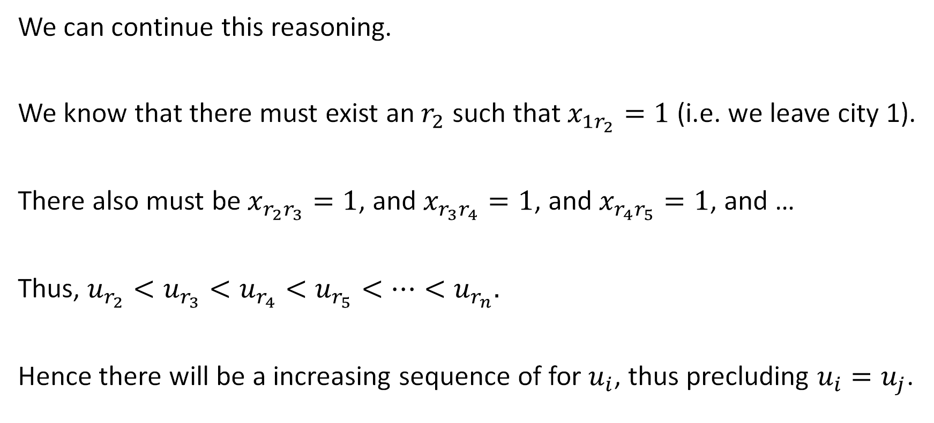
Why does this work?
We can continue this reasoning.
We know that there must exist an $r_{2}$ such that $x_{1r_{2}}=1$ (i.e. we leave city 1).
There also must be $x_{r_{2}r_{3}}=1$, and $x_{r_{3}r_{4}}=1$, and $x_{r_{4}r_{5}}=1$, and …
Thus, $u_{r_{2}}<u_{r_{3}}<u_{r_{4}}<u_{r_{5}}<…<u_{r_{n}}.$
Hence there will be a increasing sequence of for $u_{i}$, thus precluding $u_{i}=u_{j}$.

Slide 18
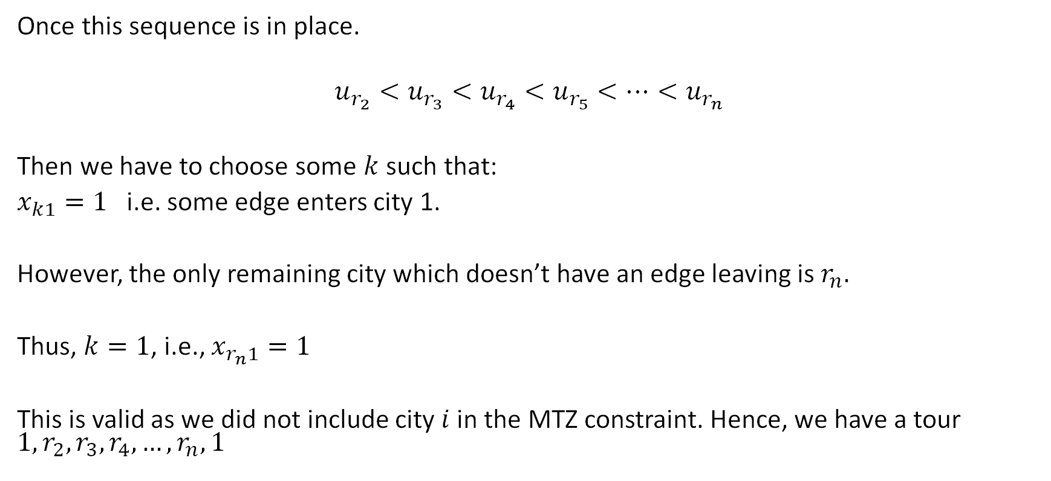
Why does this work?
Once this sequence is in place.
$$u_{r_{2}}<u_{r_{3}}<u_{r_{4}}<u_{r_{5}}<…<u_{r_{n}}$$
Then we have to choose some $k$ such that:
$x_{k1}=1$ i.e. some edge enters city 1.
However, the only remaining city which doesn’t have an edge leaving is $r_{n}.$
Thus, $k=1$, i.e., $x_{r_{n}1}=1$
This is valid as we did not include city $i$in the MTZ constraint. Hence, we have a tour $1,r_{2},r_{3},r_{4},…,r_{n},1$

Slide 19

Miller-Tucker-Zemlin (MTZ) Formulation
$$\text{min}\text{. }\sum_{\left(i,j\right)∈E}{c_{ij}x_{ij}} \\ s.t.$$
$$\sum_{j=1:i≠j}^{n}{x_{ij}=1 ∀i∈\{1, …,n\}}$$
$$\sum_{j=1:i≠j}^{n}{x_{ji}=1 ∀i∈\{1, …,n\}}$$
$$u_{i}−u_{j}+1≤\left(n−1\right)\left(1−x_{ij}\right) ∀i,j∈\left\{2,…, n\right\}:i≠j$$
$$x_{ij}∈\{0,1\}$$
$$u_{i}∈R$$

Slide 20
Pyomo Code
I have created a demonstration that you can upload to Google Colab.
You will find this on Blackboard.
Let’s try and solve larger and larger problems…

Slide 21
Heuristics
We can search for a good sub-optimal solution.
Traveling Salesman Problem Visualization - YouTube

Slide 22
Tutorial
Please use the ipynb notebook to investigate the travelling salesman problem (TSP) - https://colab.research.google.com/drive/1aGaOpyRexxRXKdu_it68ua8crXVCvNSl?usp=sharing
  You should try out the problem.
  Increase the problem size, when does it become unreasonable to solve?
  Try messing around with the parameters of the genetic algorithm, such as mutation, crossover and population. Can you solve larger TSP problems than the MILP can?
I would like you to do some research on the travelling salesman problem.
  Why is it hard to solve?
  What is NP-Hard?
  What is Combinatorial Optimisation

Slide 23
A must watch video
Math Encounters: "Optimal Tours: The Traveling Salesman Problem" with Bill Cook on August 4, 2021

